Slide 1
HDL Behavioral Modeling

Slide 2
Behavioral Modeling
Behavioral modeling represents digital circuits at a functional and algorithmic level.
It is used mostly to describe sequential circuits, but can also be used to describe combinational circuits.
Behavioral descriptions use the keyword always followed by a list of procedural assignment statements.
The target output of procedural assignment statements must be of the reg data type.
A reg data type retains its value until a new value is assigned.

Slide 3
Behavioral Modeling 2-to-1-line mux
The procedural assignment statements inside the always block are executed every time there is a change in any of the variable listed after the @ symbol. (Note that there is no “;” at the end of always statement)
//Behavioral description of 2-to-1-line multiplexer
module mux2x1_bh(A,B,select,OUT);
input A,B,select;
output OUT;
reg OUT;
always @(select or A or B)
if (select == 1) OUT = A;
else OUT = B;
endmodule

Slide 4
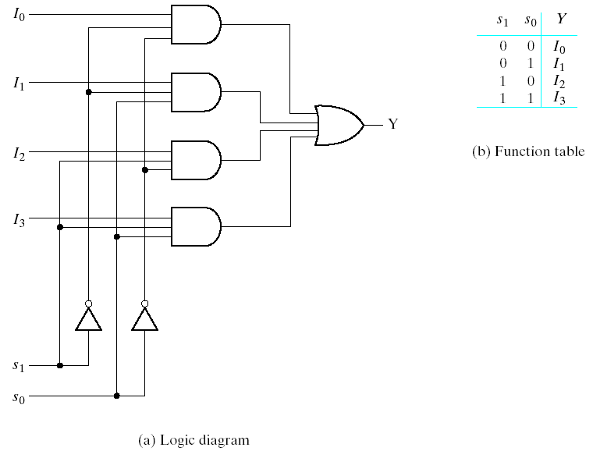
Behavioral Modeling - 4-to-1 line multiplexer
4-to-1 line multiplexer

Slide 5
Behavioral Modeling 4-to-1 line multiplexer
//Behavioral description of 4-to-1 line mux
module mux4x1_bh (i0,i1,i2,i3,select,y);
input i0,i1,i2,i3;
input [1:0] select;
output y;
reg y;
always @(i0 or i1 or i2 or i3 or select)
case (select)
2'b00: y = i0;
2'b01: y = i1;
2'b10: y = i2;
2'b11: y = i3;
endcase
endmodule

Slide 6
Behavioral Modeling 4-to-1 line multiplexer
In 4-to-1 line multiplexer, the select input is defined as a 2-bit vector and output y is declared as a reg data.
The always block has a sequential block enclosed between the keywords case and endcase.
The block is executed whenever any of the inputs listed after the @ symbol changes in value.

Slide 7
Descriptions of Circuits
Structural Description – This is directly equivalent to the schematic of a circuit and is specifically oriented to describing hardware structures using the components of a circuit.
Dataflow Description – This describes a circuit in terms of function rather than structure and is made up of concurrent assignment statements or their equivalent. Concurrent assignments statements are executed concurrently, i.e. in parallel whenever one of the values on the right hand side of the statement changes.

Slide 8
Descriptions of Circuits
Hierarchical Description – Descriptions that represent circuits using hierarchy have multiple entities, one for each element of the Hierarchy.
Behavioral Description – This refers to a description of a circuit at a level higher than the logic level. This type of description is also referred to as the register transfers level.

Slide 9
2-to-4 Line Decoder – Data flow description
//2-to-4 Line Decoder: Dataflow
module dec_2_to_4_df(E_n,A0,A1,D0_n,D1_n,D2_n,D3_n);
input E_n, A0, A1;
output D0_n,D1_n,D2_n,D3_n;
assign D0_n=~(~E_n&~A1&~A0);
assign D1_n=~(~E_n&~A1& A0);
assign D2_n=~(~E_n& A1&~A0);
assign D3_n=~(~E_n& A1& A0);
endmodule

Slide 10
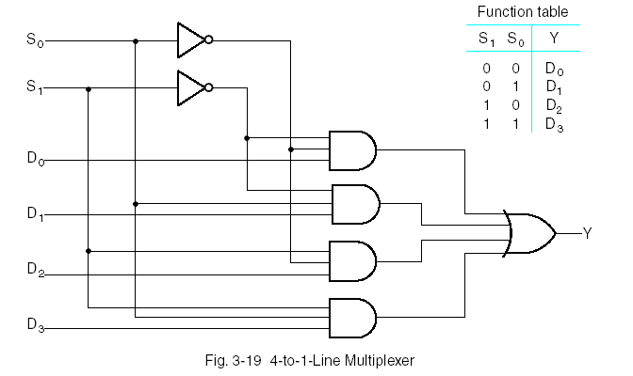
4-to-1 Multiplexer

Slide 11
4-to-1 Multiplexer
//4-to-1 Mux: Structural Verilog
module mux_4_to_1_st_v(S,D,Y);
input [1:0]S;
input [3:0]D;
output Y;
wire [1:0]not_s;
wire [0:3]N;
not g0(not_s[0],S[0]),g1(not_s[1],S[1]);
and g2(N[0],not_s[0],not_s[1],D[0]), g3(N[1],S[0],not_s[1],D[0]), g4(N[2],not_s[0],S[1],D[0]), g5(N[3],S[0],S[1],D[0]);
or g5(Y,N[0],N[1],N[2],N[3]);
endmodule

Slide 12
4-to-1 Multiplexer – Data Flow
//4-to-1 Mux: Dataflow description
module mux_4_to_1(S,D,Y);
input [1:0]S;
input [3:0]D;
output Y;
assign Y = (~S[1]&~S[0]&D[0])|(~S[1]&S[0]&D[1]) |(S[1]&~S[0]&D[2])|(S[1]&S[0]&D[3]);
endmodule
//4-to-1 Mux: Conditional Dataflow description
module mux_4_to_1(S,D,Y);
input [1:0]S;
input [3:0]D;
output Y;
assign Y = (S==2’b00)?D[0] : (S==2’b01)?D[1] : (S==2’b10)?D[2] : (S==2’b11)?D[3]:1’bx;;
endmodule

Slide 13
4-to-1 Multiplexer
//4-to-1 Mux: Dataflow Verilog Description
module mux_4_to_1(S,D,Y);
input [1:0]S;
input [3:0]D;
output Y;
assign Y=S[1]?(S[0]?D[3]:D[2]):(S[0]?D[1]:D[0]);
endmodule

Slide 14
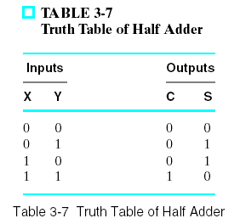
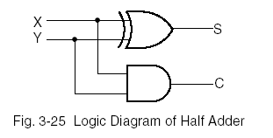
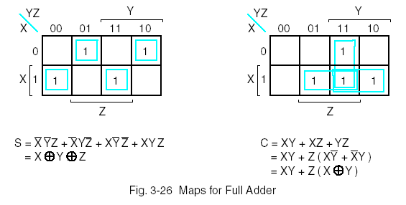
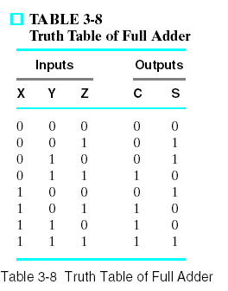
Adder

Slide 15
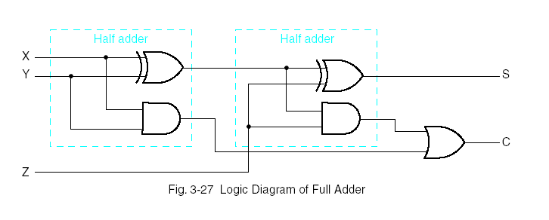
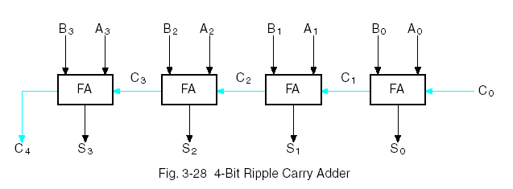
4-bit Adder

Slide 16
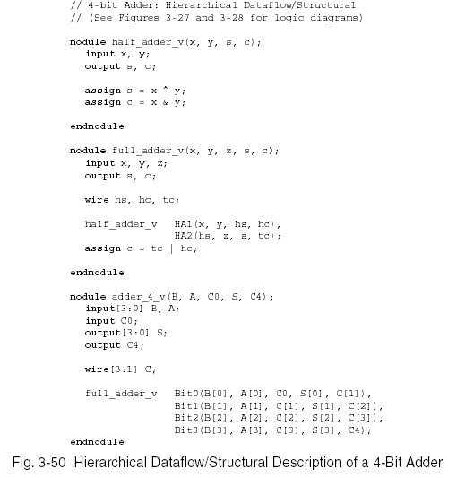
4-bit-Adder

Slide 17
4-bit Adder
//4-bit adder : dataflow description
module adder_4bit (A,B,C0,S,C4);
input [3:0] A,B;
input C0;
output [3:0]S;
output C4;
assign {C4,S} = A + B + C0;
endmodule

